Slide 1
TD3 - answers
Writing a cover letter

Slide 2
Common layout
of a formal cover letter

Slide 3
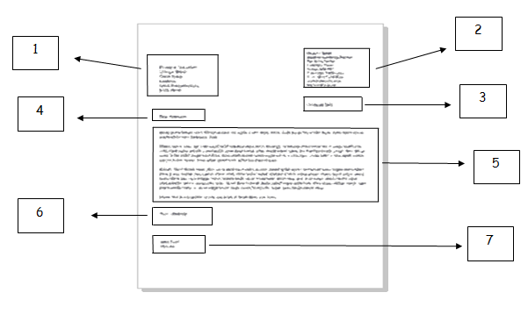
address
The of the person you are writing to
The inside address should be written on the left, starting below your address.
2. Your
The return address should be written in the top right-hand corner of the letter.
Tel:
address
+33 6- xx-xx-xx-xx (+ exemples)

Slide 4
3. Date
Different people put the date on different sides of the page. You can write this on the right or the left on the line after the address you are writing to. Write the as a word.
Write the following dates in English:
12 octobre 2021 :
mardi 5 juillet 2020 :
21 février 1999 :
mercredi 16 juin :
month
October 12(^{th)}, 2021
Tuesday, July 5(^{th)}, 2020
February 21(^{st)}, 1999
Wednesday, June 16

Slide 5
4. Salutation or greeting
a) If you do not know the name of the person you are writing to, use the following form:
(try to find out a name.)
b) If you know the name, use the title (Mr, Mrs, Miss or Ms, Dr, etc.) and the last name only. If you are writing to a woman and do not know if she uses Mrs or Miss, you should use which is for both married and single women.
Dear Mr Jenkins, Dear Ms Hawers, Dear Dr Greene, Dear Professor Iverson…
Dear Sir or Madam,
Ms [miz]

Slide 6
II. The content of your cover letter

Slide 7
1. Opening Paragraph Briefly identify yourself and the position you are applying for. Add how you found out about the vacancy.
2. Paragraph 2 Give the reasons why you are interested in working for the company and why you wish to be considered for that particular post. State your relevant qualifications and experience, as well as your personal qualities that make you a suitable candidate.
3. Paragraph 3 Inform them that you have enclosed your current resume and add any further information that you think could help your case.
4. Closing Paragraph (6) Give your availability for an interview, thank them for their consideration, restate your interest and close the letter.

Slide 8
Yours Faithfully
is used if the recipient is known and addressed by the name.
Yours Sincerely
is used if the name of the recipient is not known

Slide 9
5. Signature (7)
Sign your name, then print or write it underneath the signature.
First name first! Biden Joe ➔ Joe Biden

Slide 10
III. Common abbreviations used in letters

Slide 11
3. Abbreviations Used in Letters
The following abbreviations are widely used in letters:
Enc. = Enclosure
Pp. = Per procurationem
Ps. = Post script
Pto. = Please turn over
RSVP = Please reply

Slide 12
IV. Practice. Translate into English

Slide 13
Je me permets de vous écrire :
Je souhaite postuler pour le stage de (…) dont vous avez publié l’annonce dans… :
Je suis disponible pour un entretien le… :
Veuillez trouver mon CV ci-joint:
J'attends avec impatience la possibilité de pouvoir discuter avec vous :
Dans l’attente d’une réponse de votre part :
I am writing (to you)
I wish to (I would like to) apply for the training period (UK)/ internship (US) of… (which/that) you advertised in / at / on… .
I am available for an interview (on)…
Please find my CV (UK) /resume (US) enclosed.
I look forward to discussing with you.
I am looking forward to meeting you.
I look (I am looking) forward to hearing from you.

Slide 14
V. Important vocabulary

Slide 15
Useful adjectives you can use in your letter:
Team oriented, flexible, adaptable, hard-working, open-minded, easy-going, creative, diligent, trustworthy, motivated, reliable, organized, autonomous, studious, attentive, conscientious, persistent, dynamic, energetic, enterprising, enthusiastic, consistent, professional, methodical, skillful… (feel free to find more at home)

Slide 16
VI. Emails

Slide 17
Now, can you find the abbreviations widely used in emails?
as soon as possible :
when you send a copy of a letter to more than one person, you use this
abbreviation to let them know:
when you send a copy of a letter to someone else but you do not want
the recipient to know:
What are the translations to the following expressions?
Veuillez trouver en fichier-joint:
Cordialement :
asap
Cc: carbon copy
Bcc: blind carbon copy
Please find attached/
in an attachment
Best Regards

Slide 18
VII. Match each symbol with how you say it:

Slide 19
H | .
h | @
- | /
_ | \
Capital H
Dot
small ‘h’
At
hyphen (US)/dash (UK)
Slash
Back slash
underscore

Slide 20
➔ practice : what are your email address and phone number? (work with a classmate)

