Slide 1
CLONING

Slide 2
GRAMMAR expressing willingness AND INTENTIONS

Slide 3
1. a. same subjects
I want to sleep. (c’est le sujet qui veut dormir)
My friend needs to go to the hospital. (la personne qui doit aller à l’hôpital est mon ami = même sujet)
Negation: I don’t want to leave now.

Slide 4
1. b. different subjects
I want you to go to work.
My parents don’t want me to drink alcohol.
Negation: I don’t want you to cry. / I want you not to cry. ➔ (le sujet de la “volonté” et le sujet de l’action sont différents)

Slide 5
1. c. other uses of “will”
Difference between will as a verb and will for the future tense
Examples: a. She was willing to help.
b. He won’t answer the phone. ➔ how would you translate this?
c. Person A: Say hi to your sister for me.
Person B: Will do. ➔ how would you translate this? Exprimer le fait qu’on le fera. D’accord / Je le ferai / promis / ça marche (mais avec une idée de futur)
Il refuse de répondre au téléphone.

Slide 6
2. Exercise Translate the following sentences into English.

Slide 7
1, J’aimerais que tu me respectes.
2, Je m’attends à ce que Jane se fâche.
3, Ils ne veulent pas que nous les aidions.
4, Nous avons besoin que tu télécharges ce document.
I would like you to respect me.
I expect Jane to get angry.
I am expecting Jane to get angry.
They don’t want us to help them.
We need you to download this document.

Slide 8
5, Il refuse de se faire tester.
6, Je ne veux pas que tu sois triste.
He won’t get tested.
I don’t want you to be sad.

Slide 9
Video
« Why we still haven’t cloned humans. It’s not just ethics. »
(stop at 4’50)
https://www.youtube.com/watch?v=VYexAg2J6Kc

Slide 10
What is your definition of cloning?

Slide 11
What is your definition
of cloning?
Instructions: with your group, write a common definition of what you think cloning is.
You will then share your definition with the rest of the class. (You will copy the def. when the teacher asks for it).

Slide 12
What is your definition
of cloning?
Your written answers

Slide 13
Britannica’s definition:
Cloning is «the process of generating a genetically identical copy of a cell or an organism.»

Slide 14
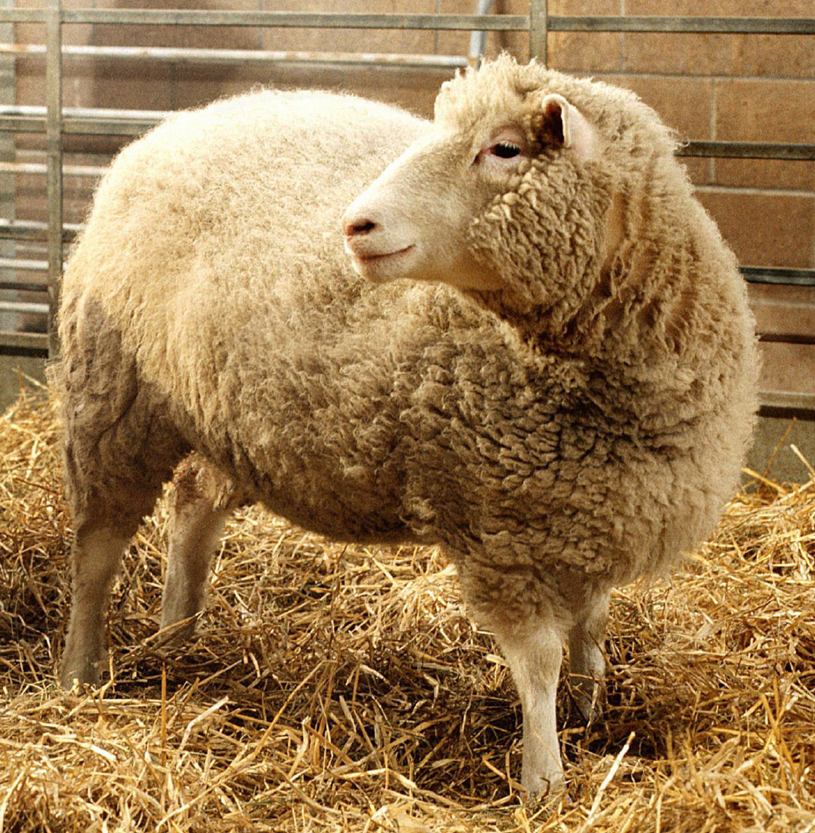

Slide 15
Vocabulary

Slide 16
See « livret corrIgé » sur celene for corrections

Slide 17
After watching…

Slide 18
Now, what do you know about Dolly?

Slide 19
JURASSIC parK

Slide 20
1. How were dinosaurs made?

Slide 21
2. As scientists, do you believe their explanation makes sense? Explain.

