Slide 1
GMOs

Slide 2
What does « GMO » stand for?

Slide 3
Genetically
Modified
Organism(s)

Slide 4
What is your definition
of GMOs? What, why, how, what for?
Write a sentence.

Slide 5
Britannica’s definition :
“organism whose genome has been engineered in a laboratory in order to favor the expression of desired physiological traits or the generation of desired biological products.”

Slide 6
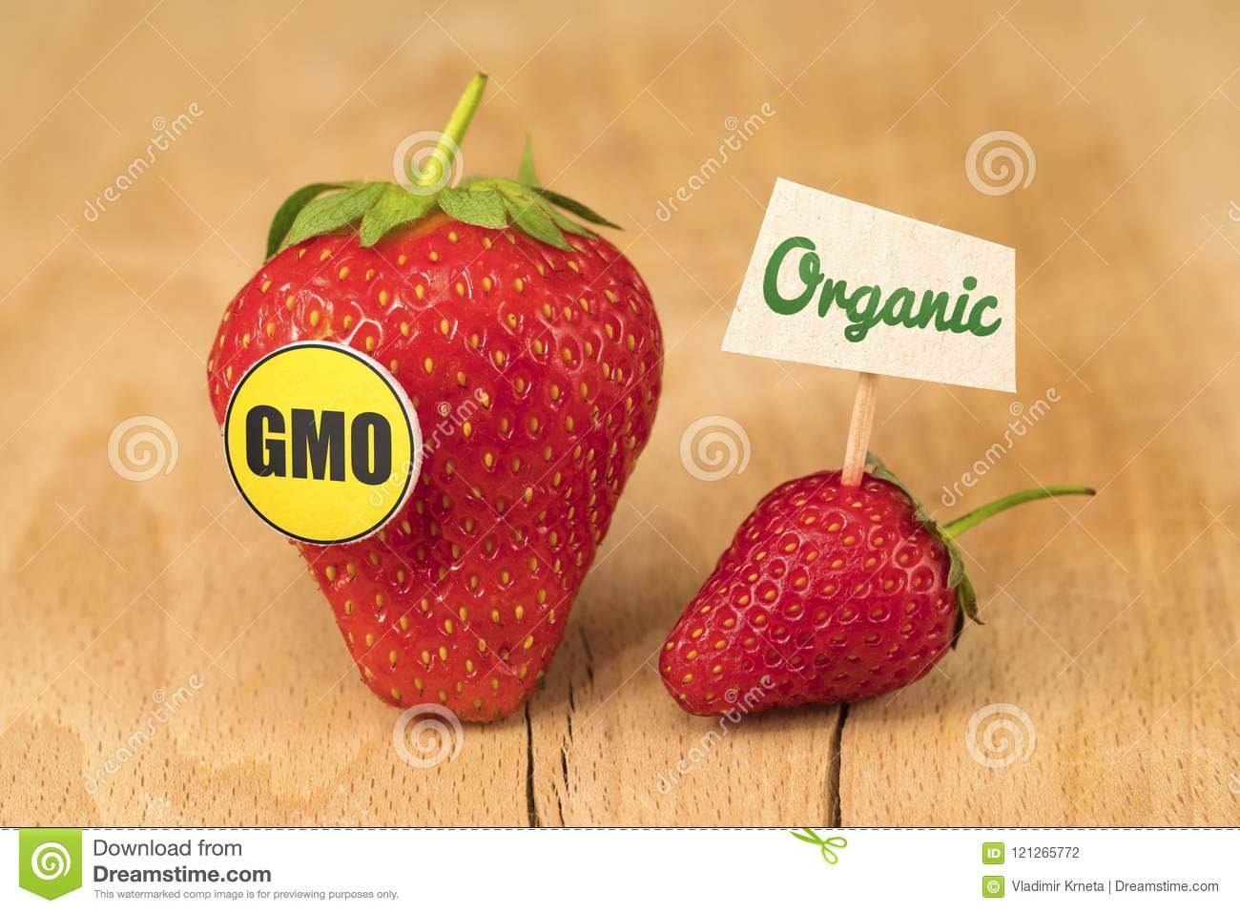

Slide 7
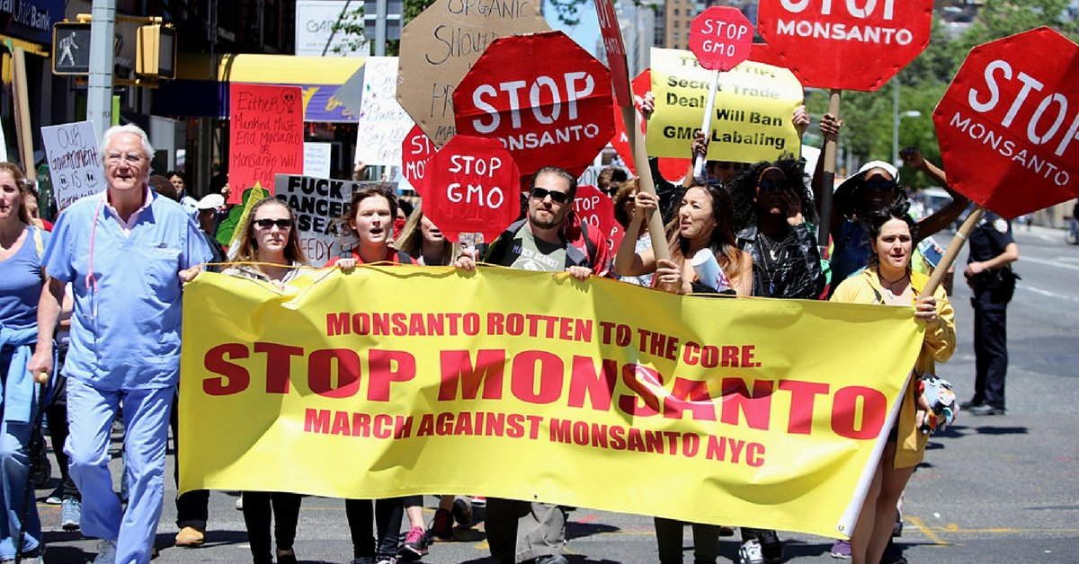

Slide 8
1.a. GRAMMAR Adjective order

Slide 9
1. a. recap on adjective order
1. She just bought a nice white silk shirt.
2. He is a handsome young man
3. I love old blue Spanish paintings.
What is the adjective order?

Slide 10
Adjective order
“QOSASCOMP”
(Quantity) Opinion, Size, Age, Shape, Color, Origin, Material, Purpose
😊➔ On Saturdays And Sundays, Carol Often Makes Pies.

Slide 11
1. b. Exercise Make compound nouns from the French equivalents below.

Slide 12
1. La Reine Elizabeth portait toujours de vilaines robes vertes en soie.
2. Passe-moi je gros sac bleu, s’il te plait.
3. Mon meilleur ami a des nouvelles chaussures de sport noires.
“QOSASCOMP”
Queen Elizabeth used to wear ugly green silk dresses.
Please give (/hand) me the big blue bag.
My best friend has new black sports shoes.

Slide 13
4. La bibliothèque a de nombreux livres neufs et anciens intéressants.
5. Mon voisin a une incroyable piscine rouge en plastique et en forme de cœur.
“QOSASCOMP”
The library has many (=numerous) interesting old and new books.
My neighbor has an amazing heart-shaped red plastic swimming pool.

Slide 14
6. Deux archéologues britanniques ont découvert un superbe petit temple égyptien en marbre noir.
“QOSASCOMP”
Two British archeologists found/discovered a beautiful little black Egyptian marble temple.

Slide 15
Video
« The GMO story in only three minutes»
https://www.youtube.com/watch?v=nbKOTRwnDpY

Slide 16
2. Vocabulary

Slide 17
1. récolter |  | 2. selon
3. Des champs |  | 4. prospérer, monter en flèche
5. Aux dépends de, aux frais de |  | 6. rattraper, dépasser
7a. Une bactérie 7b. Des bactéries |  | 8. Le spectre, l’éventail, la gamme
To harvest
According to
fields
To boom
At the expense of
To overtake
a bacterium
bacteria
The spectrum

Slide 18
9. isoler |  | 10. Des mauvaises herbes
11. muter |  | 12. En plus de tout cela
13. involontaire |  | 14. le croisement animal
15. La santé |  | 16. accorder
To isolate
weeds
To mutate
On top of this
unintended
crossbreeding
health
To grant

Slide 19
17. Sans parler de |  | 18. Il était une fois
19. De nos jours |  | 20. engloutir
21. élevage |  | 22. Des aliments transformés
23. Maïs = « corn » = |  | 24. Du colza
Not to mention
Once upon a time
nowadays
To swallow up
husbandry
Processed food
maize
rape

Slide 20
25. étiqueter |  | 26. Un manque de
27. Empêcher de faire qch |  | 28. écrasant
To label
A lack of
To prevent from V+ing
overwhelming

Slide 21
3. PHONETICS
What words do these phonetic transcriptions correspond to?

Slide 22
1. [ʤəˈnetɪklɪˈmɒdɪfaɪdˈkrɒps]:
2. [ˈnaʊəˌdeɪz]:
3. [ɔːˈgænɪkˈfʊːd]:
4. [ˈhɑː(r)vɪst]:
5. [ˈhʌzbəndri]:
6. [ˈhɜː(r)bɪsaɪd]:
7. [ˈeɪʒə]:
8. [ˈkɒnstəntli]:
9. [ˈɪnˌvaɪrənˈment(ə)li]:
10. [/helθ/]:
genetically modified crops
nowadays
organic food
harvest
husbandry
herbicide
Asia
constantly
environmentally
health

Slide 23
4. ORAL SUMMARY of bill gates’ video
Go over your notes
With your group, come up with a summary

Slide 24
5. Your opinion
Do you believe GMOs are the solution to world hunger?

