Slide 1
BIOMETRICS

Slide 2
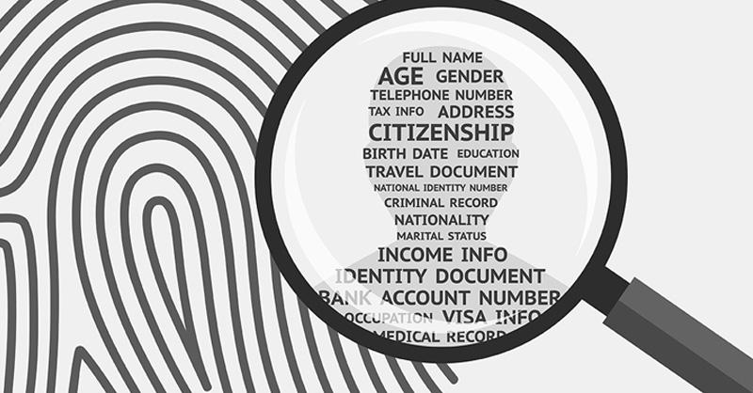

Slide 3
VOCABULARY

Slide 4
Le globe oculaire |  | Une tendance
Les empreintes digitales |  | Des faux positifs
Précision |  | S’abonner, souscrire
Rivaliser, etre en concurrence |  | Un sms
Monter (à bord) de |  | Depuis / pour longtemps
 | Où quelqu’un va, où quelqu’un se trouve, allées venues | S’accroître, s’étendre
The eyeball
A trend
Fingerprints
False positives
Accuracy
To subscribe
To compete
A text message
To board
For a while
whereabouts
To expand

Slide 5
EXTRA QUESTION (if time allows)

Slide 6
Share your opinion with your classmates:
Give your opinion
Listen to your classmates’ opinions
Find arguments
Find examples (from movies, novels, everyday life…)
In their fight against terrorism, should governments be allowed to collect all of our personal data?

